Slide 1

WAY TO ENTERPRISE
Database Basics
VTI ACADEMY
Author: duy.nguyenngoc1@vti.com.vn
March 2020

Slide 2
Agenda
Stored Procedure
Function
Optional JOIN
Assignments
Copyright © VTI Academy All Rights Reserved

Slide 3
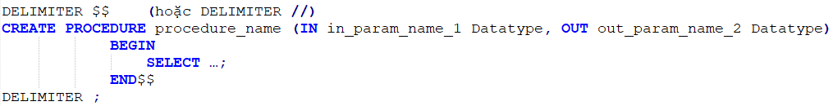
STORED PROCEDURE
Create
Call
Drop

Slide 4
Syntax
DELIMITER $$ Meaning
Parameter IN, OUT
The difference between Parameter and Variable

Slide 5
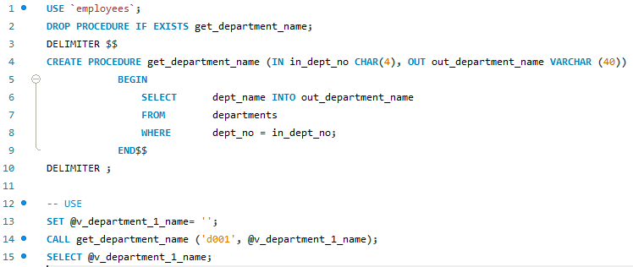
EXAMPLE 1

Slide 6
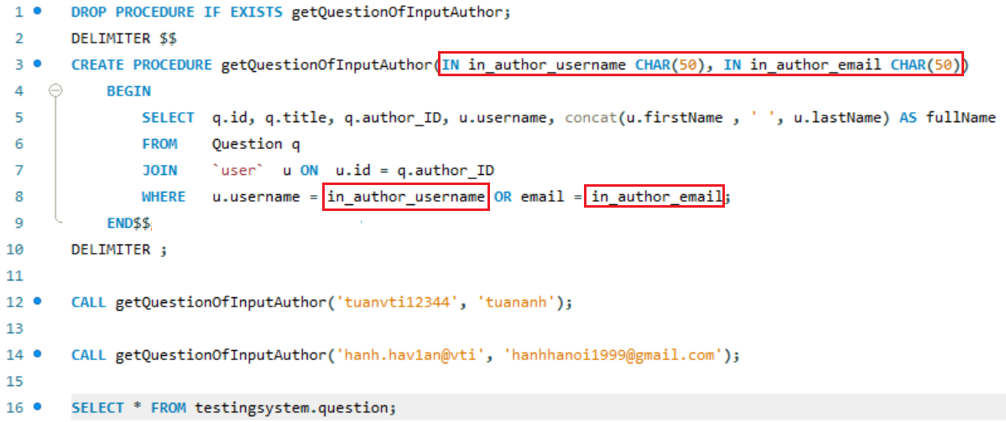
EXAMPLE 2

Slide 7
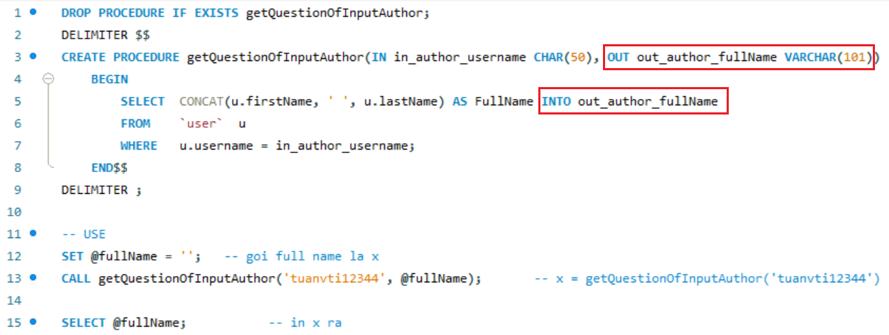
EXAMPLE 3

Slide 8
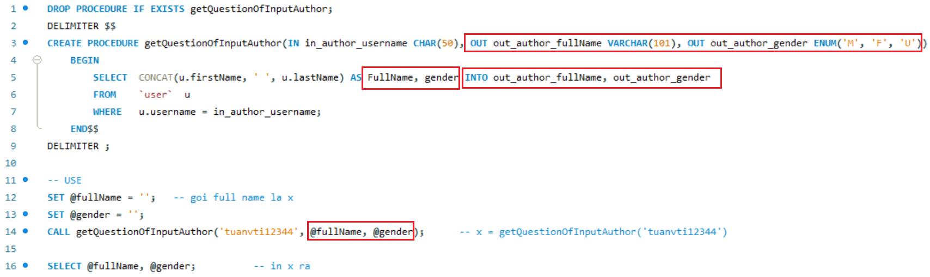
EXAMPLE 4

Slide 9
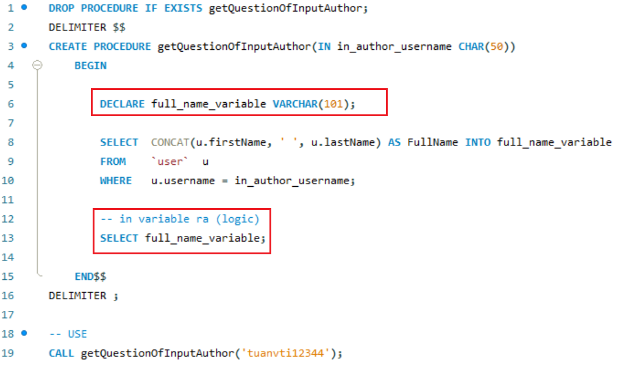
EXAMPLE 5

Slide 10
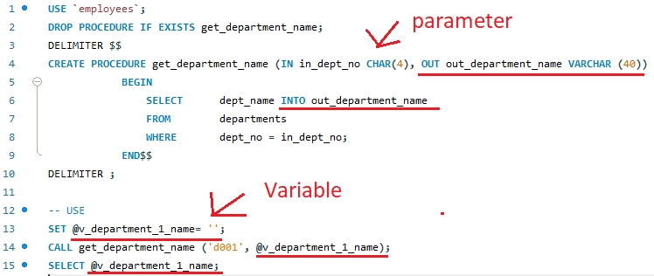
Assign value for parameter OUT

Slide 11
Function
User-defined function
Built-in functions

Slide 12
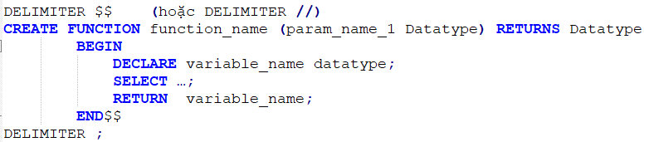
User-defined function
Create
Call
Drop

Slide 13
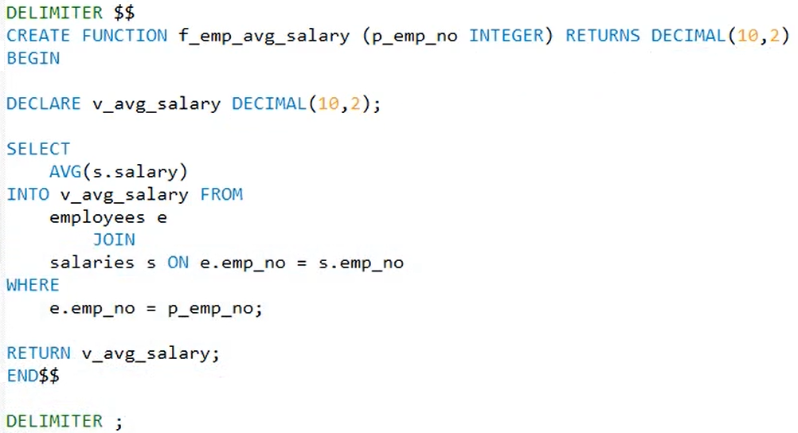
Example
SET GLOBAL log_bin_trust_function_creators = 1;

Slide 14
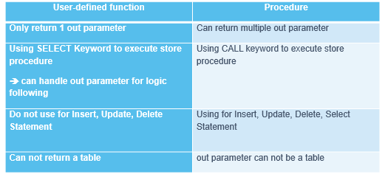
The Comparasion function and Stored Procedure

Slide 15
Built-in functions
Aggregate functions
Date time functions
Other
  Round
  String
  IFNULL() & COALESCE()

Slide 16
Aggregate functions
COUNT()
The difference of COUNT(column_name), COUNT(*), COUNT(1), COUNT(0)
  COUNT(column_name) count all values which is # null
  COUNT(*) count all rows of query which is satisfied condition
  COUNT(1) là count all value, which is 1 (similar COUNT(*))
  In addition, we can count distanct value (Using COUNT(DISTINCT column_name))
SUM()
MIN()
MAX()
AVG()
Note:
  Aggregate functions apply for value # null

Slide 17
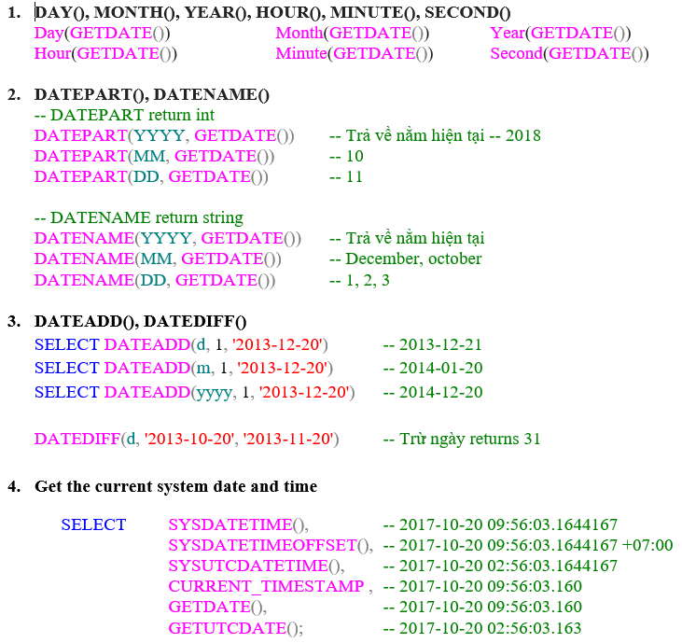
DateTime functions
https://www.w3schools.com/sql/func_mysql_date_add.asp

Slide 18
Optional JOIN
ON DELETE
ON UPDATE
Mode
  CASCADE
  NO ACTION
  SET NULL
  SET DEFAULT

Slide 19
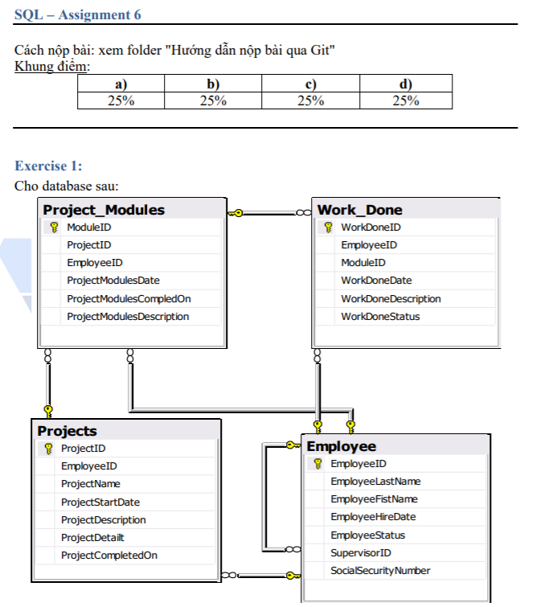
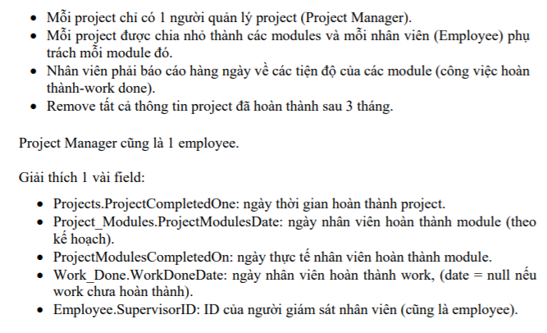
Assignments 1

Slide 20
Assignments 1

Slide 21
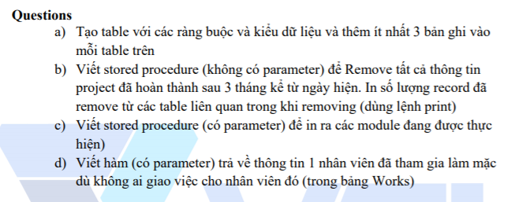
Assignments 1

Slide 22
Assignments 2
Assignments for Testing System

Slide 23
Q & A
Copyright © VTI Academy All Rights Reserved

